Slide 1
Global Electronics EDA
Vignesh

Slide 2
Contents
01
Problem Statement
02
Approach
03
Analysis Steps
04
Results

Slide 3

Global Electronics
Leading Retailer
Consumer electronics company providing datasets on customers, products, sales, stores, and currency exchange rates

Slide 4

Data Analytics Team's Task
Comprehensive EDA
Uncover insights to enhance customer satisfaction, optimize operations, and drive business growth

Slide 5



Business Use Cases
Marketing Strategies
Inventory Management
International Pricing
Enhance marketing campaigns, develop better products, plan effective promotions
Optimize inventory and sales forecasting
Understand currency exchange rate impact on sales

Slide 6
Approach
02

Slide 7

Data Cleaning and Preparation
Handle Missing Values
Convert data types, merge datasets
Load Data
Insert preprocessed data into SQL database
Power BI Visualization
Connect to SQL
Import data and create interactive dashboards

Slide 8
Analysis Steps
03

Slide 9
Customer Analysis
Demographic Distribution
Analyze customer gender, age, location
Purchase Patterns
Identify order value, purchase frequency, preferred products
Segmentation
Group customers based on demographics and behavior

Slide 10
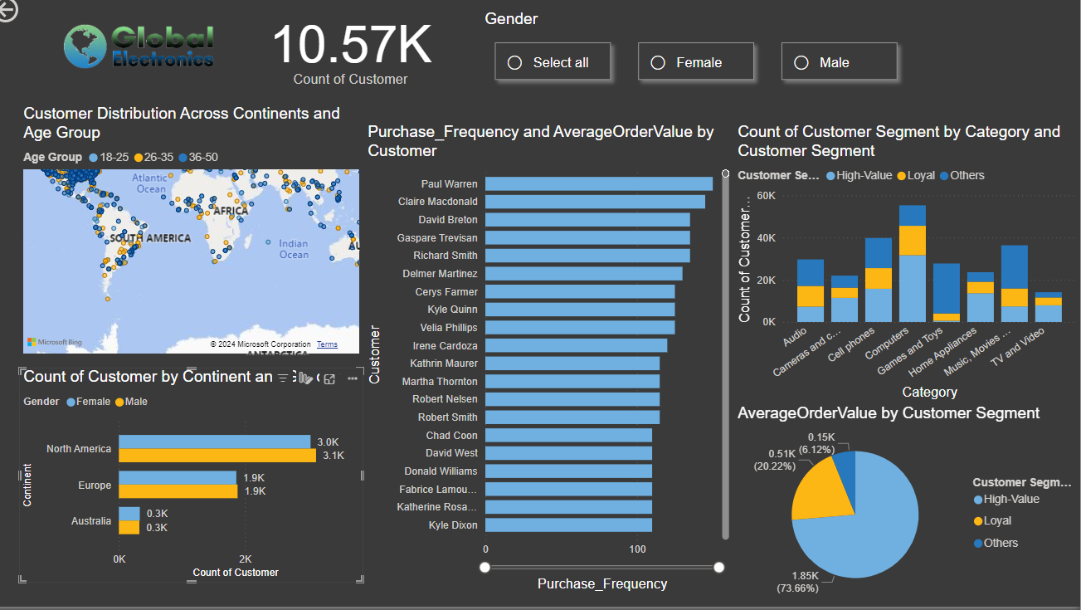

Slide 11




Sales Analysis
Overall Performance
Sales by Product
Sales by Store
Sales by Currency
Analyze total sales, trends, and seasonality
Evaluate top-performing products
Assess store performance
Examine currency impact on sales

Slide 12
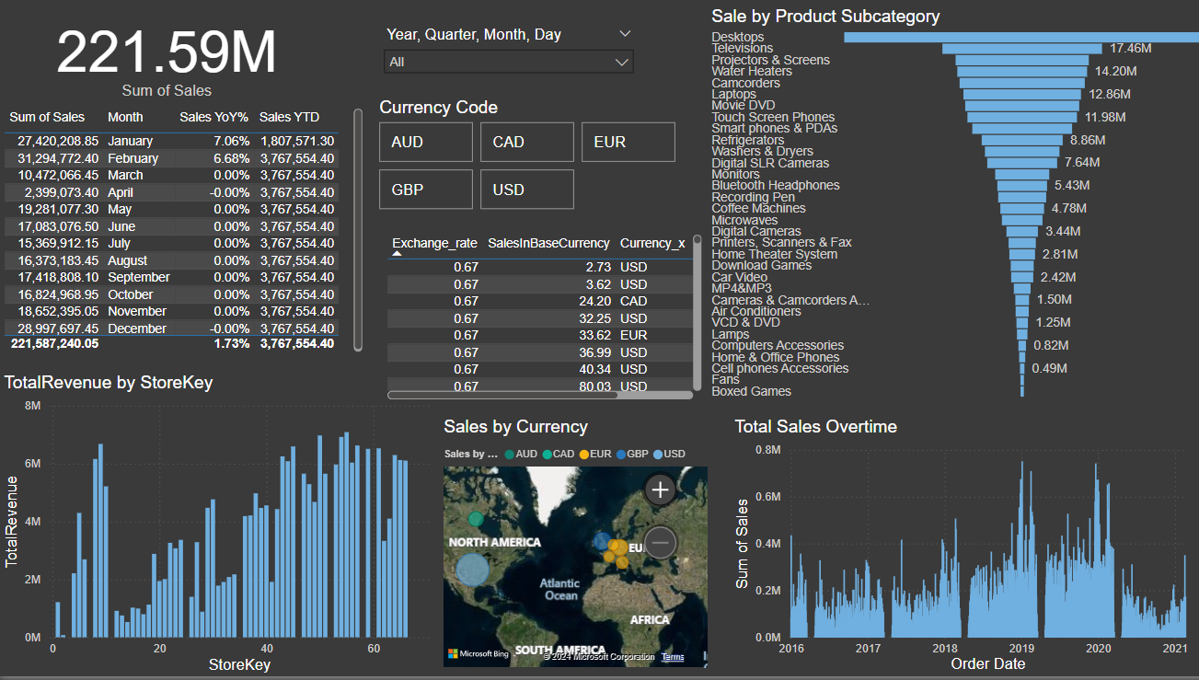

Slide 13

Product Analysis
Product Popularity
Profitability
Category Analysis
Identify most and least popular products
Calculate profit margins
Analyze sales performance across categories

Slide 14
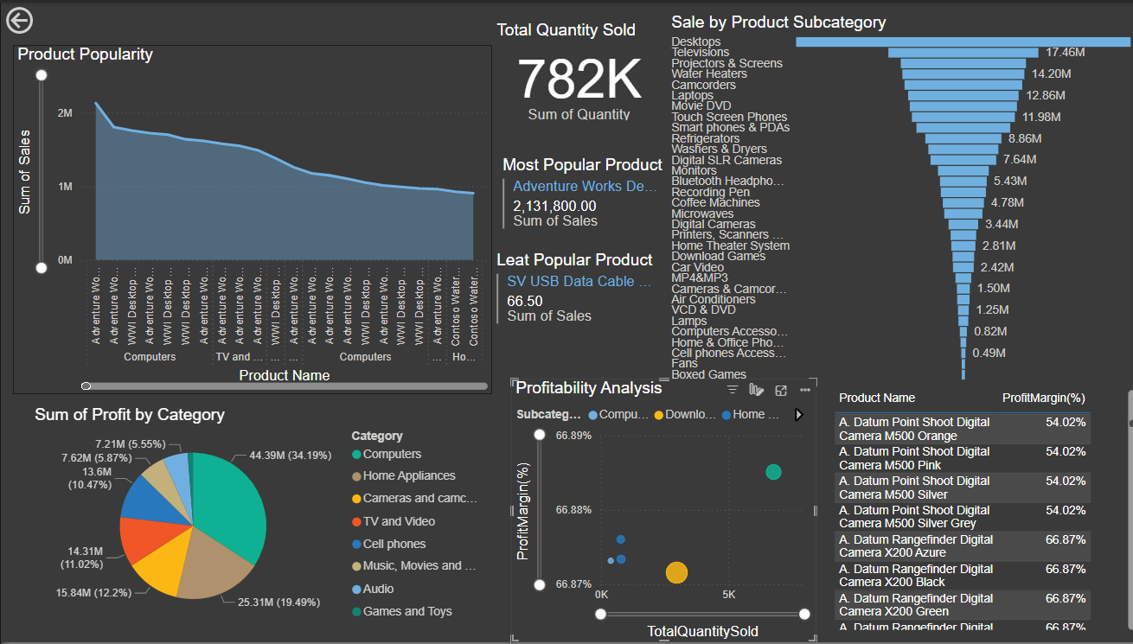

Slide 15

Store Analysis
Store Performance
Geographical Analysis
Evaluate sales, size, and operational data
Analyze sales by store location

Slide 16
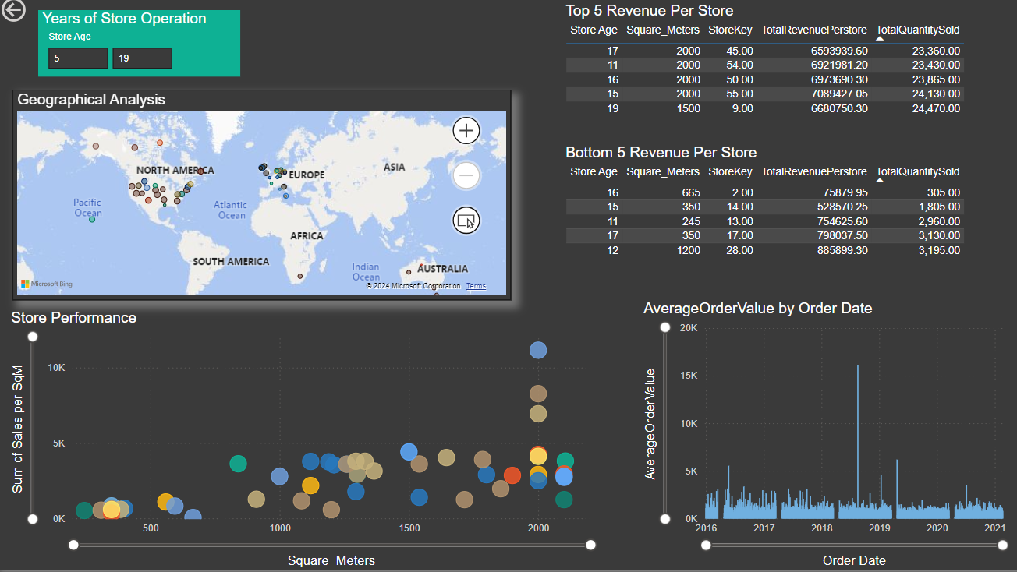

Slide 17
Results
04

Slide 18
Summary
50+ age group is high-value customer segment based on order value
Majority of high-value customers preferrred computers and many of them located in United States.
Customers who aren’t loyal and high-value is preferring Games and Toys Category.
USA has highest total sale value when compared to other countries (France bottom).
Total sales increased year afte year from 2016-2019. After that there is a decrease in sales which may be due to missing data for the year 2020 and 2021.
Desktops are the #1 sales subcategory for many years expect the year 2016. Computer accessories are the least preferred subcategory.
Most popular product is Adventure works desktop silver and least popular product is SV USB Data cable.
Movie DVD subcategory has highest profit margin(67%) than Desktops. Though computer accessories are sold low quanitity but has good profit margin (66%)

Slide 19
Summary
Bigger the store, higher the sales per Sq.M. Store operation age does matter to gain trust with customers and to improve the sales
The United States has a total quantity sold that is four times higher than that of the United Kingdom, significantly surpassing many other countries. This disparity suggests that consumers in Europe and the UK may benefit from certain advantages. In contrast, countries like Canada and Australia face higher costs due to unfavorable exchange rates.

Slide 20
Thank You
Name

